Slide 1
Cybersecurity
Rogue Access Points and Evil Twins

Slide 2

Rogue Access

Slide 3



Evil Twin

Slide 4
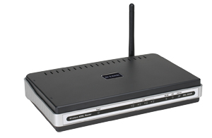
Rogue Access Points
Very simple to connect a SOHO wireless AP
Extends network to unauthenticated WiFi traffic beyond your control
May conflict with existing network, causing problems
Periodic wireless surveys
Walk around your building/campus
“Wardriving”/“Warwalking”
Use third-party tools
Kismet
NetStumbler
WiFi Pineapple
Consider using 802.1X (Network Access Control)
Users must authenticate, connection type doesn’t matter

Slide 5
Wireless Evil Twin
Any regular wireless access point
Configured exact same way as existing network
Same SSID, security settings
“Louder” the existing access points
More power
Directional antennas
Clients connect to rouge access point rather than enterprise network
Opens door to all sorts of nasty tricks!

